Slide 1
Service Performance Centre

Slide 2
Are You Missing These 3 Hidden Levers in Your Service Business?
Retention
Efficiency
Growth

Slide 3

The Burning Problem
What if 20% of your revenue is at risk – and you don’t know which 20%?
What if your ‘stable’ accounts are secretly unhappy?
Let’s uncover the invisible risks hiding in the data

Slide 4
The 3 Levers
The Churn
The Tickets
The Silent Growth
Today, we’ll try to unlock these levers – but first let’s see why they matter

Slide 5

The Churn
Suppose 24 accounts are ticking. But which ones? And why?
We might think we know, but we can go wrong…

Slide 6
The Ticket
One team is drowning in 132 tickets. Who’s rescuing them?

Slide 7
The Silent Growth
Some clients are ready to give more revenue. Are we listening?

Slide 8
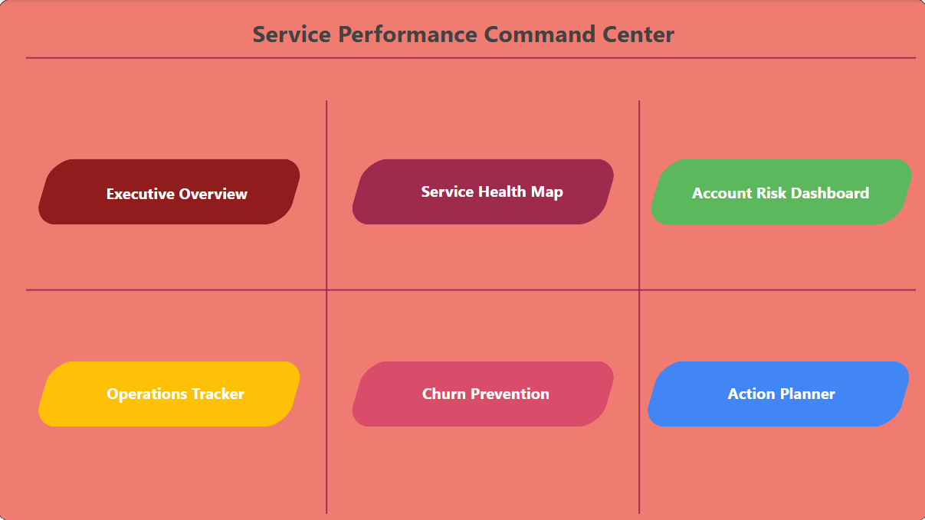
The Solution
What if you could get all these data with just 5 clicks or less?
Let me show you how

